Slide 1
Unit III Time Series Analysis
P.RAJESH
Dept of ECE
JNTUACEA

Slide 3
Introduction:
We know that planning about future is very necessary for the every business firm, every govt. institute, every individual and for every country.
Every family is also doing planning for his income expenditure.
As like every business is doing planning for possibilities of its financial resources & sales and for maximization its profit.
Definition: “A time series is a set of observation taken at specified times, usually at equal intervals”.
“A time series may be defined as a collection of reading belonging to different time periods of some economic or composite variables”. –Ya-Lun-Chau
▪ Time series establish relation between “cause” & “Effects”.
▪ One variable is “Time” which is independent variable & and the second is “Data” which is the dependent variable.

Slide 4
Example:
From example 1 it is clear that the sale of milk packets is decrease from Monday to Friday then again its start to increase.
• Same thing in example 2 the population is continuously increase.

Slide 5
Importance of Time Series Analysis:-
As the basis of Time series Analysis businessman can predict about the changes in economy.
There are following points which clear about the its importance:
1. Profit of experience.
2. Safety from future
3. Utility Studies
4. Sales Forecasting 5. Budgetary Analysis
6. Stock Market Analysis 7. Yield Projections
8. Process and Quality Control 9. Inventory Studies
10. Economic Forecasting 11. Risk Analysis & Evaluation of changes.
12. Census Analysis

Slide 6
Components of Time Series:-
The change which are being in time series, They are effected by Economic, Social, Natural, Industrial & Political Reasons. These reasons are called components of Time Series.
❑ Secular trend :-
❑ Seasonal variation :-
❑ Cyclical variation :-
❑ Irregular variation :

Slide 7
Secular trend:
The increase or decrease in the movements of a time series is called Secular trend.
A time series data may show upward trend or downward trend for a period of years and this may be due to factors like:
❑ increase in population,
change in technological progress ,
large scale shift in consumers demands,
For example,
• population increases over a period of time,price increases over a period of years,production of goods on the capital market of the country increases over a period of years.These are the examples of upward trend.
• The sales of a commodity may decrease over a period of time because of better products coming to the market.This is an example of declining trend or downward.

Slide 8
Cyclical Variations:
Cyclical variations are recurrent upward or downward movements in a time series but the period of cycle is greater than a year. Also these variations are not regular as seasonal variation.
A business cycle showing these oscillatory movements has to pass through four phases-prosperity, recession, depression and recovery. In a business, these four phases are completed by passing one to another in this order.

Slide 9
• Irregular variation:
Irregular variations are fluctuations in time series that are short in duration, erratic in nature and follow no regularity in the occurrence pattern. These variations are also referred to as residual variations since by definition they represent what is left out in a time series after trend ,cyclical and seasonal variations.
Irregular fluctuations results due to the occurrence of unforeseen
events like :
• Floods,
• Earthquakes,
• Wars,
• Famines

Slide 10
Time Series Model
• Addition Model:
Y = T + S + C + I
Where:- Y = Original Data
T = Trend Value S = Seasonal Fluctuation
C = Cyclical Fluctuation I = Irregular Fluctuation
• Multiplication Model:
Y = T x S x C x I or
Y = TSCI

Slide 11
Measurement of Secular trend:-
• The following methods are used for calculation
of trend:
❑ Free Hand Curve Method:
❑ Semi – Average Method:
❑ Moving Average Method:
❑ Least Square Method:

Slide 12
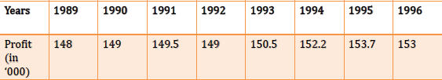
Free hand Curve Method:-
• In this method the data is denoted on graph paper. We take “Time” on ‘x’ axis and “Data” on the ‘y’ axis. On graph there will be a point for every point of time. We make a smooth hand curve with the help of this plotted points.
Example:
Draw a free hand curve on the basis of the following data:

Slide 14
Semi – Average Method:-
• In this method the given data are divided in two parts, preferable with the equal number of years.
• For example, if we are given data from 1991 to 2008, i.e., over a period of 18 years, the two equal parts will be first nine years, i.e.,1991 to 1999 and from 2000 to 2008.
In case of odd number of years like, 9, 13, 17, etc.., two equal parts can be made simply by ignoring the middle year.
For example, if data are given for 19 years from 1990 to 2007 the two equal parts would be from 1990 to 1998 and from 2000 to 2008 - the middle year 1999 will be ignored

Slide 15
• Example:
Find the trend line from the
following data by Semi – Average Method:-

Slide 45
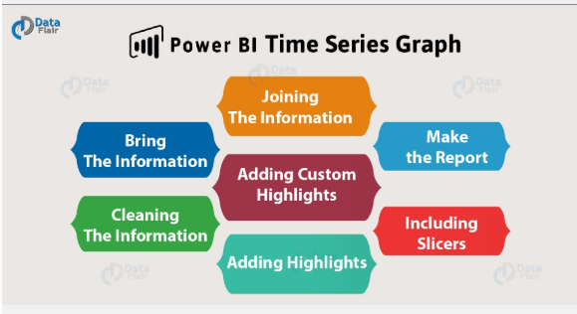
To create time series graph in Power BI

Slide 46
